Slide 1
Source lithology and conditions

Slide 2
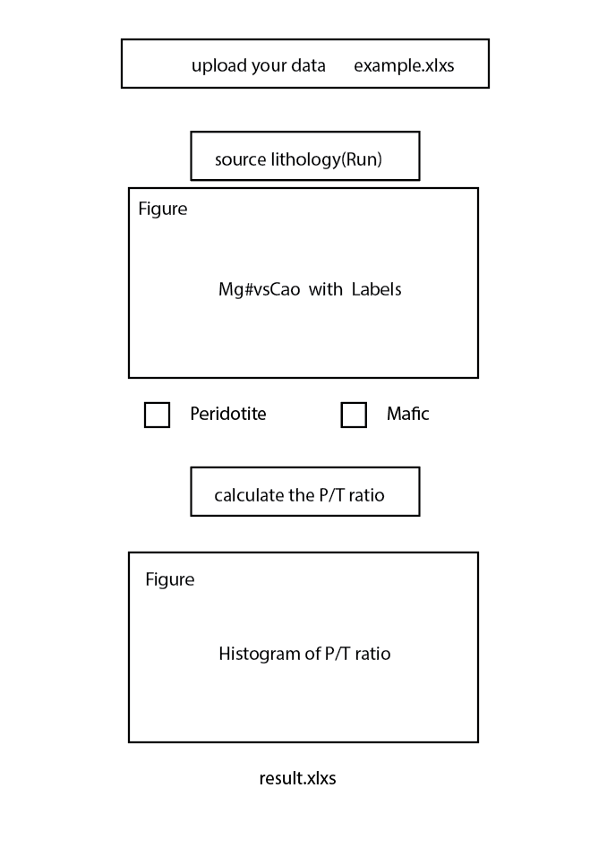
Introduction
User need upload
User need click
We show the figure
User need choose
User need click
We show the figure
We provide the result

Slide 3
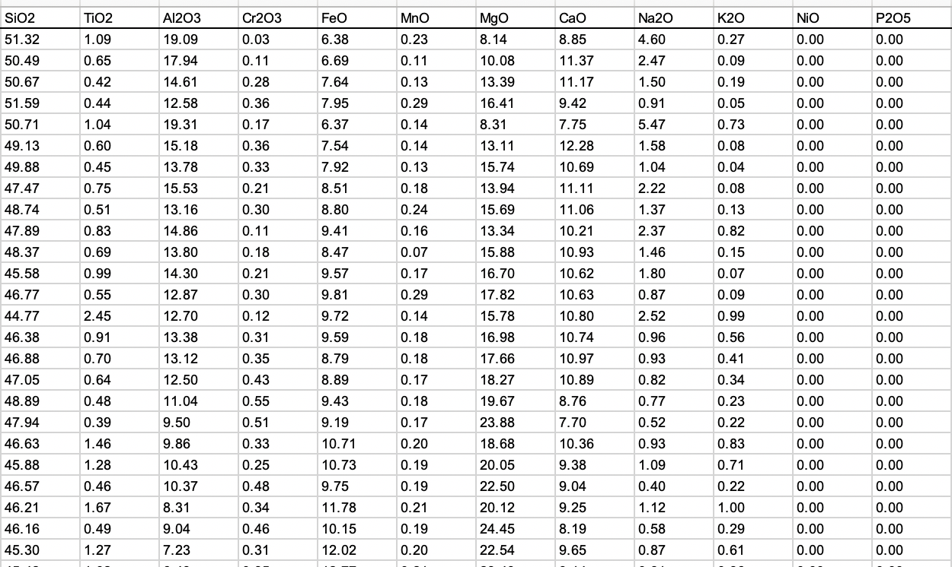
Example

Slide 4
ANN Classification model
ANN regression model
Model and database we already build using python

Slide 5
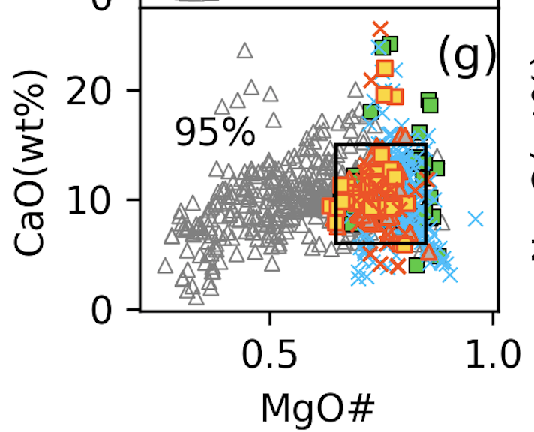
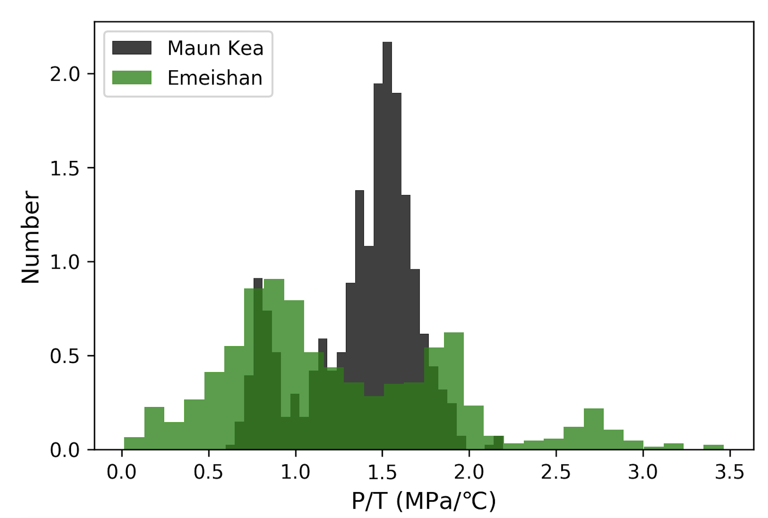

Slide 6
Their data with our labels and P/T ratio

